Slide 1
Forgotten Voices
The First World War in Africa
A CWGC education resource

Slide 2
‘Why were some people who died in the First World War remembered, while others were forgotten?’

Slide 3
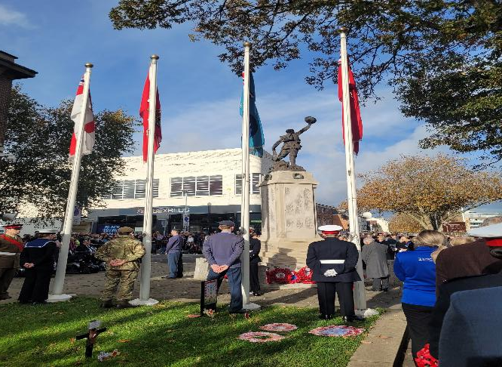
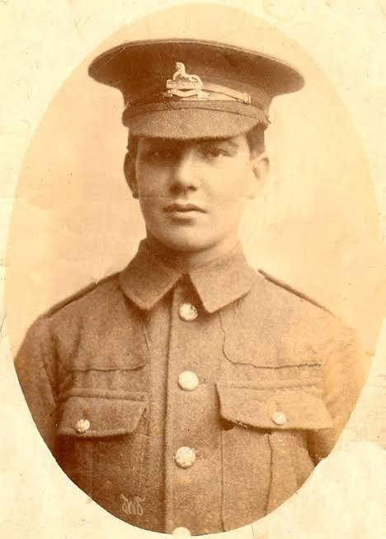
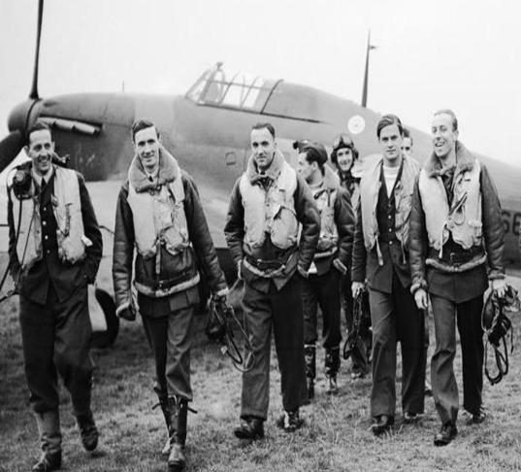
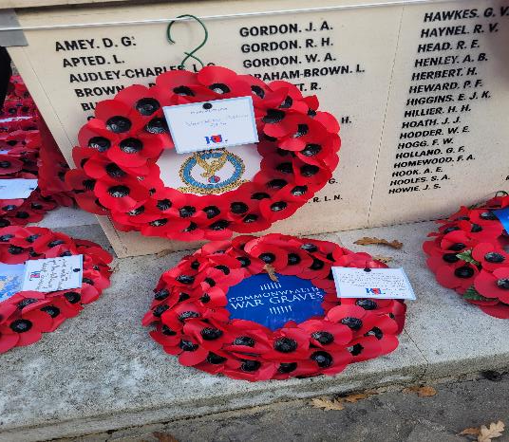
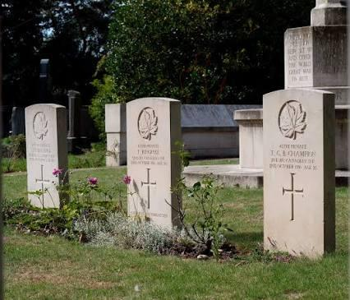
Who gets remembered when there is a war?
How do we remember?
Notes:
Drawing out ideas of traditional Eurocentric memorials, poppies etc
After the World Wars, the Commonwealth War Graves Commission was created to make sure people who died in the wars were remembered. They care for graves and memorials around the world so that those who died are not forgotten.
Then introduce the challenge:
But what if some people weren't remembered in the same way as others?

Slide 4
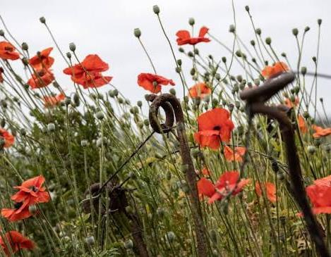
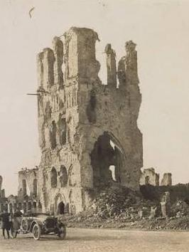
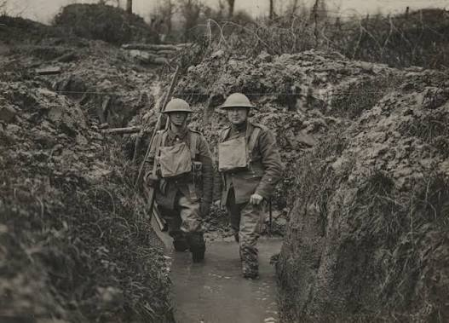
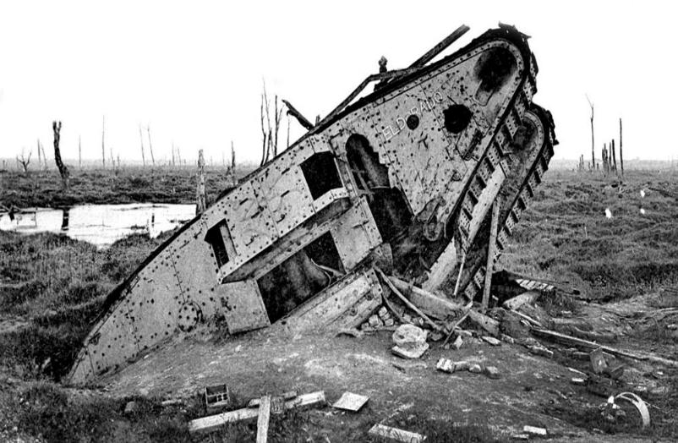
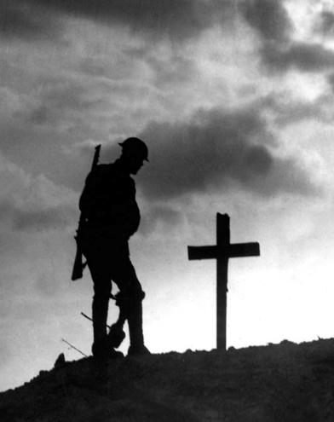
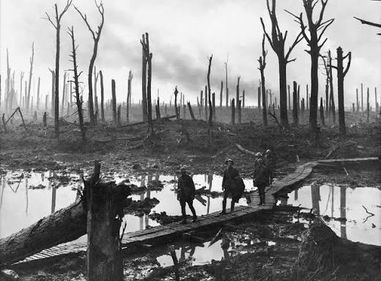
What words or pictures come into your head when we think about the First World War?

Slide 5
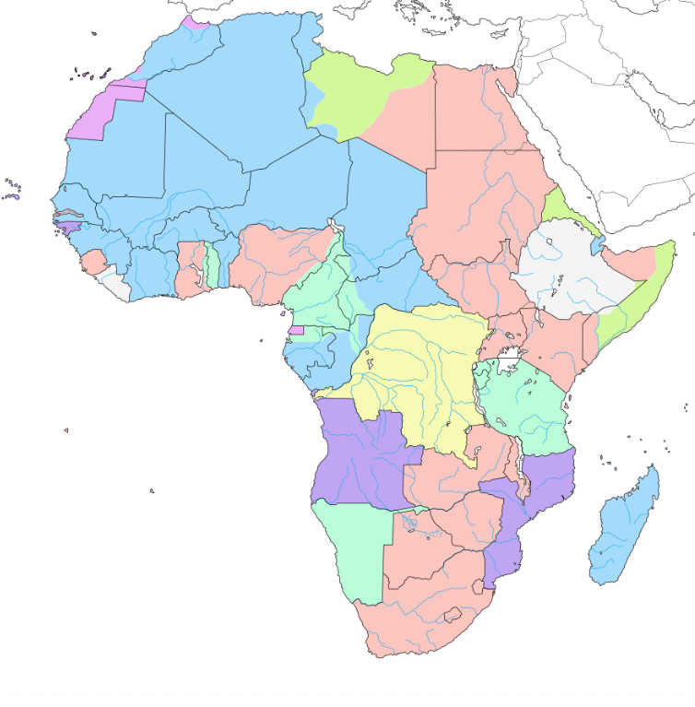
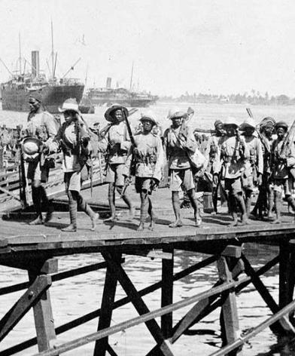
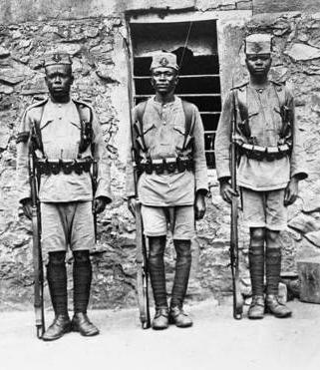
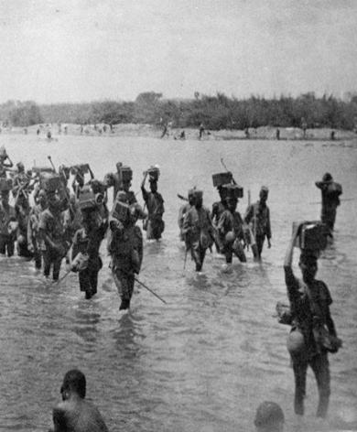
Colonial Africa 1914
Belgium
France
Germany
Italy
Portugal
Spain
United Kingdom
Independent
Notes:
How many of you know that the war took place in Africa?
Have you heard of the Kings African Rifles
What about Carrier Corps
Labour Corps
Thousands of African soldiers and Carrier Corps members died during the First World War. For many years, many of their stories were not well known and some were not commemorated equally. Today, people are working to make sure they are remembered – this is our focus today.
Further Questions
"Why do you think we know a lot about the trenches in France, but much less about what happened in Africa?"
Possible answers:
Most history books focus on Europe.
Britain's role in France is more famous.
African voices and stories were not recorded as often.
Some stories have been forgotten over time.
"Today we're going to become history detectives. We're going to uncover the stories of African soldiers, porters and families who experienced a very different First World War from the one we usually hear about
Extension – can draw out the colonial aspect and how this links to the war
By Eric Gaba – Wikimedia Commons user: Sting, CC BY-SA 3.0, https://commons.wikimedia.org/w/index.php?curid=2212637

Slide 6
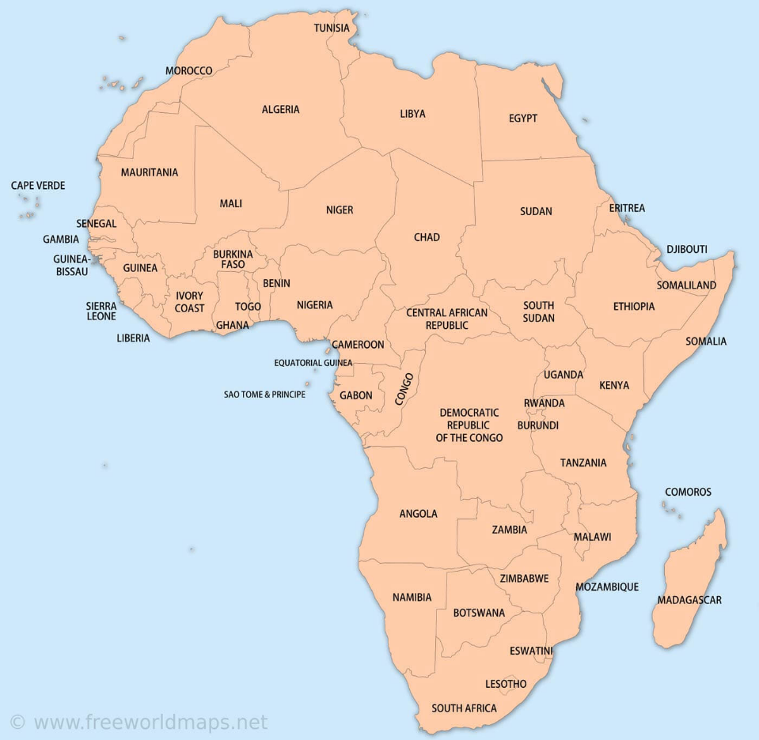
Can you find, colour and label these six countries on your map of Africa?
Sierra Leone
South Africa
Kenya
Uganda
Tanzania
Malawi

Slide 7
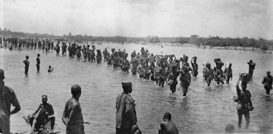
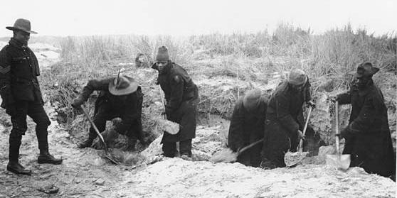
Who’s Who?
Sierra Leone Carrier Corps
King’s African Rifles
South African Native Labour Corps
Notes:
Discuss what we think these different groups were doing – what were their jobs – use pictures and titles

Slide 8
Whose job is most important?
Notes:
Students in groups of 3 – each one has a different role card
There job is to discuss whose job is most important based on what they do.
Hopefully, they come to the conclusion that they all need to work together!
The First World War relied on thousands of people doing different jobs. The King's African Rifles, Carrier Corps and South African Native Labour Corps all played vital roles, but their stories are often less well known today.

Slide 9
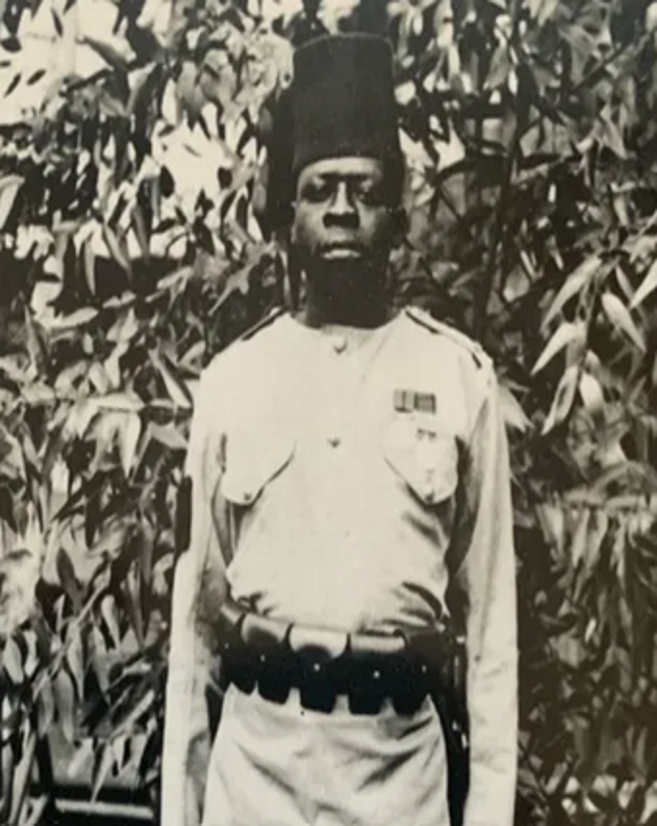
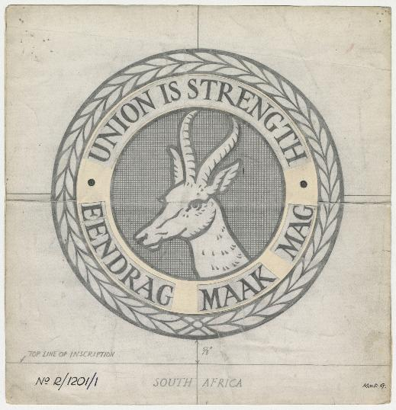
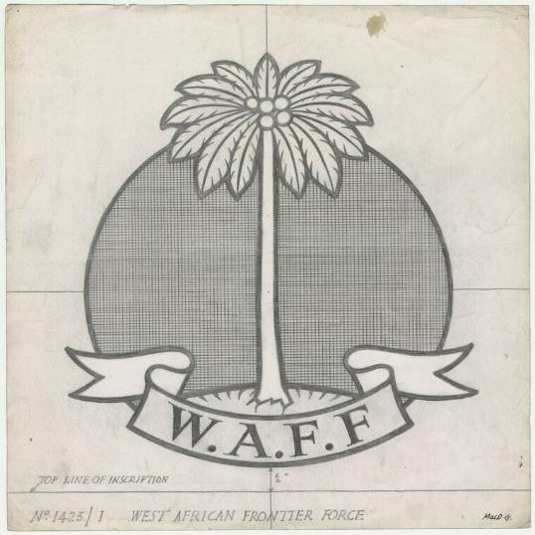
What did you learn about George, Dolly & John?
Notes:
Each group has a personal story to read. Feedback on what they learn about that person – what details we do and don’t have about them etc.
The First World War relied on thousands of people doing different jobs. The King's African Rifles, Carrier Corps and South African Native Labour Corps all played vital roles, but their stories are often less well known today.

Slide 10

Notes:
Carrier Corps film
Every one to tell me one thing that stood out or interested them

Slide 11
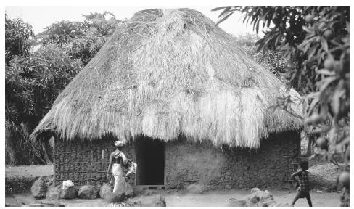
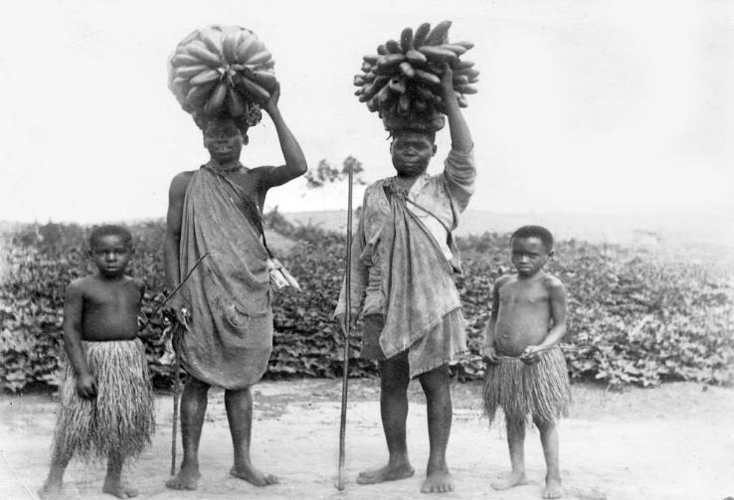
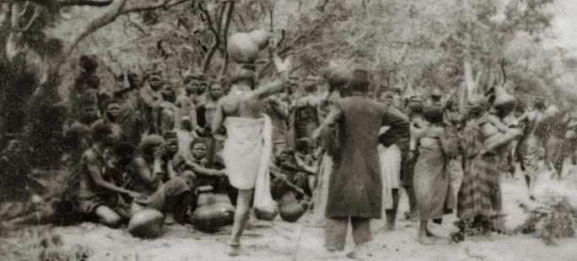
Communities at War
What happens when lots of people leave a community?
Who has to do the work?
How might life change?
Notes:
Communities at War
Some of these men volunteered, but many of these men didn’t – they were conscripted and taken away
Questions:
What happens when lots of people leave a community?
Who has to do the work?
How might life change?
Key message:
War affects families and communities too.

Slide 12
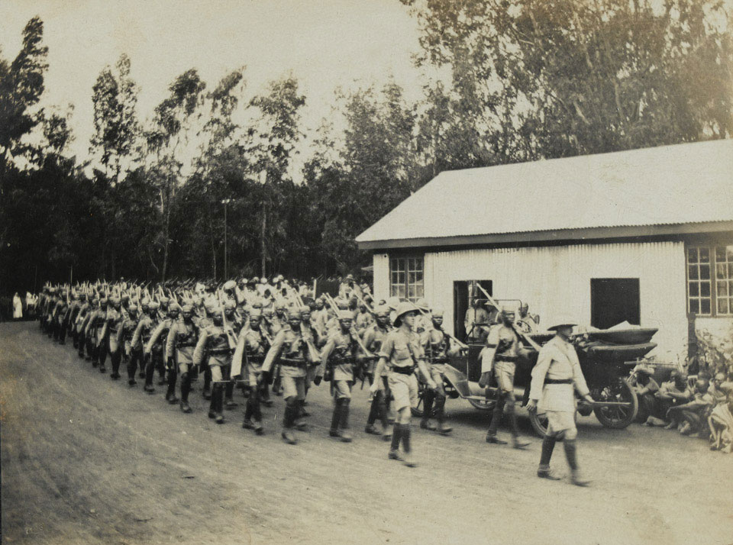
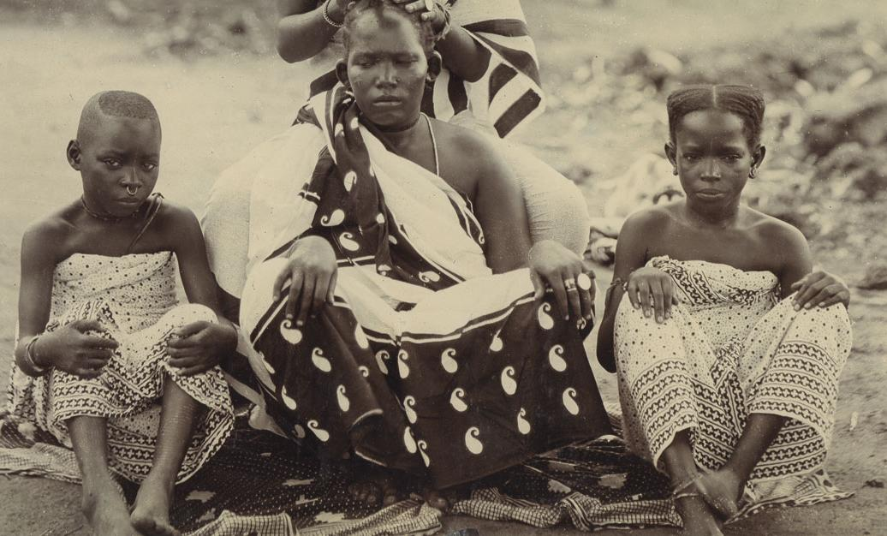
Forgotten Voices Writing Activity
What are we thinking and feeling?
Notes:
What might each person be thinking?
Lead into writing activity. Soldier/labourer/porter and wife and family – first person reflection
Half students to do one and half the other and then they will match up to read the contrasting perspectives.
Prompts:
"I am walking..."
"I miss..."
"I worry about..."
"I hope..."
OR
"Since they left..."
"Our village..."
"I feel..."

Slide 13
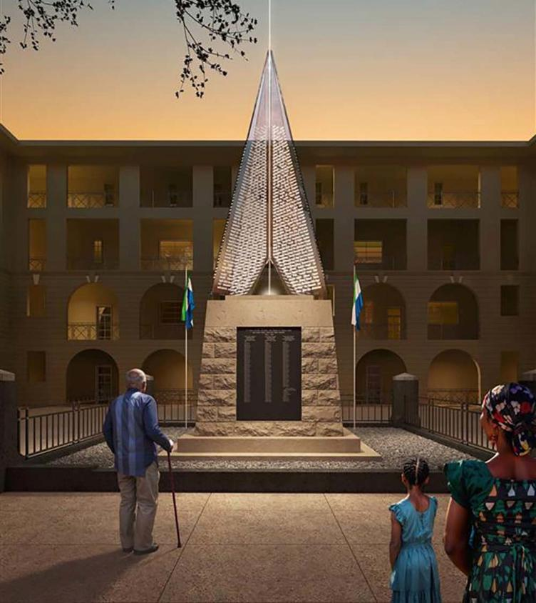
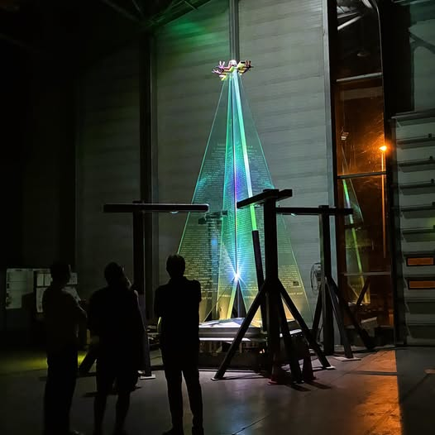
Remembering the Forgotten-The Freetown Memorial, Sierra Leone, 2026
Notes:
Why is it important we remember those forgotten now? Why build these now?
Potential questions:
What stands out?
Why might it have been designed this way?
Why use the image of light?
Why use glass?
Why build on top of the original memorial that didn’t have their names?
Why is the light designed to be so far away – up to 5K?
Use of colour?
How is it different from traditional memorial?
Why use these symbols?
Freetown Memorial | Cemetery Details | CWGC

Slide 14
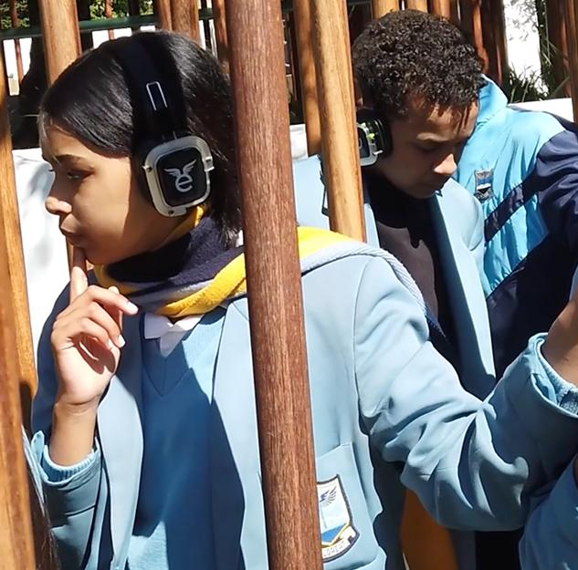
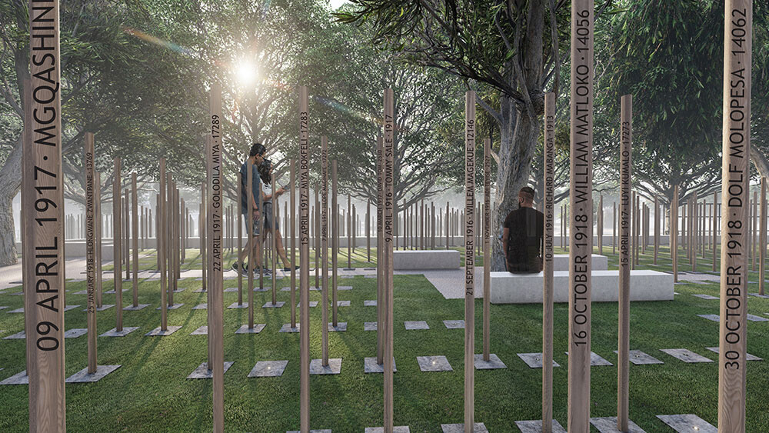
Remembering the Forgotten - The Cape Town Labour Corps Memorial, South Africa, 2025
Notes:
Potential questions:
What stands out?
Why might it have been designed this way?
What do you think the students are doing?
How would this help them understand the experience/memorial
Why are the poles made from South African hardwood?
Why do you think it is designed for people to walk around?
How is it similar/different from a traditional memorial?
Which memorial do they prefer and why?
Cape Town Labour Corps Memorial | Cemetery Details | CWGC

Slide 15

Look at Cape Town and Sierra leone memorials and discuss design etc
Why is it important we do this now?
Notes:
Watch clip and ask students to consider the similarities/differences to a traditional Remembrance service

Slide 16
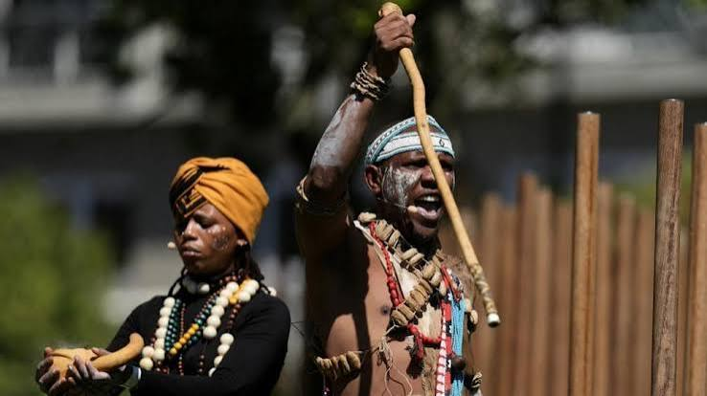
These are traditional South African praise singers and they are honouring the dead remembered at the memorial.
Why was this a key part of the ceremony?
Notes:
Praise singer Lwanda Sindaphi and Sindiswa Mabadi holding a Calabash burning sage to honour the ancestors who have passed.
During the official inauguration of the Cape Town Labour Corps Memorial in the Company’s Garden, the praise singer, Lwanda Sindaphi, performed a traditional ceremony alongside Sindiswa Mabadi.
They honored the forgotten soldiers through specific traditional and symbolic actions:
Burning Sage: They held a calabash (a traditional hollowed-out gourd) burning sage. In South African tradition, this ritual is performed to cleanse the space, connect with the spiritual world, and honor the spirits of the ancestors who have passed away
Praise Singing and Poetry: Lwanda Sindaphi performed as an imbongi (a traditional praise poet), using a powerful vocal delivery to chant the history, bravery, and sacrifices of the dead.
Symbolizing Cultural Unity: The performance was designed to bring a deeply rooted African tradition to a military remembrance ceremony, serves as a symbol of cultural unity. It ensured that these specific men were acknowledged according to their own heritage.

Slide 17
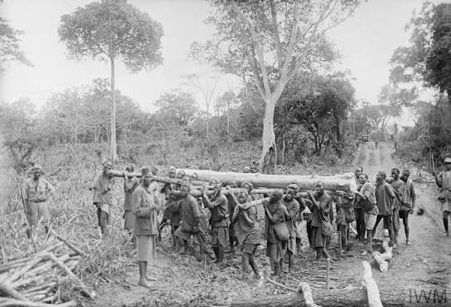
Borne: Nii Ayikwei Parks & Julian Knxx
Your Legacies Are Preserved Here: Koleka Putuma & Daljit Nagra
‘the searching of mothers roving’
‘Did we not also stand for the same cause?’
‘what tongue was cut from your history?’
‘We write to fill the void of history books’
‘from today you will be carried, you are borne, now and forever’
‘Your loved ones are still waiting for news of your return’
Notes:
Kavirondo porters of the 2nd Road Corps from British East Africa carry logs through the Chikukwe Swamp, January 1918.
Powell L A W (Lt) (Photographer), January 1918, Chikukwe Swamp.
IWM (Q 15625), http://www.iwm.org.uk/collections/item/object/205250478.
Poems were commissioned for the inauguration of both new memorials.
Poem for new Cape Town Labour Corps Memorial | CWGC
What images comes into your mind?
What feelings do they create?
Why might the poets have chosen those words?
What links are there between them?

Slide 18

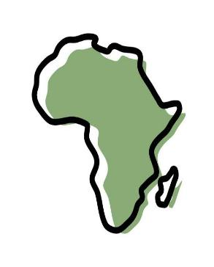
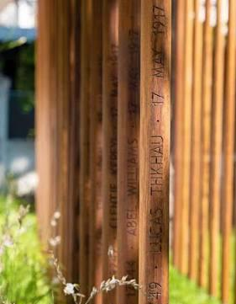

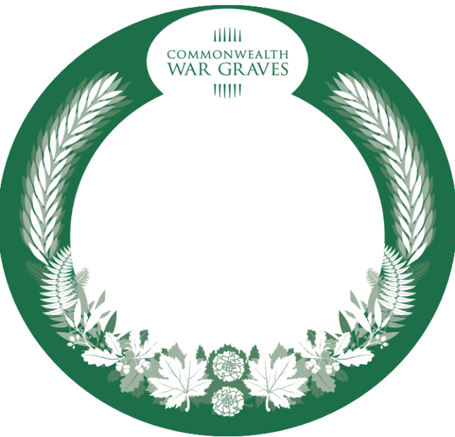

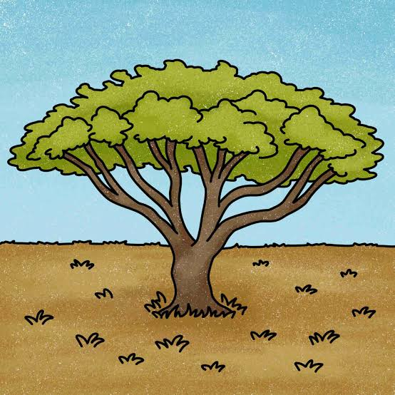


No Longer Forgotten
Your Story Matters
Your Footprints Remain
We Remember You
Notes:
The new memorials in Cape Town and Freetown were created because many African people who served in the First World War were not remembered properly. Today, your tribute is helping bring their stories into the light.

Slide 19
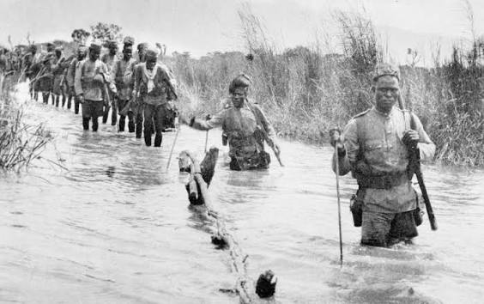
‘Why were some people who died in the First World War remembered, while others were forgotten?’
What have we learnt?
What surprised you most?
Why is it important that we remember people equally?
If remembering means keeping someone's story alive, have we remembered them today?
Notes:
Return to original enquiry question.
How many of us knew about the war in Africa or the Carrier Corps etc?
What we learnt?
What surprised you most?
Is it important that we remember people equally?
"If remembering means keeping someone's story alive, have we remembered them today?"

